Slide 1
Tactics Board

Slide 2
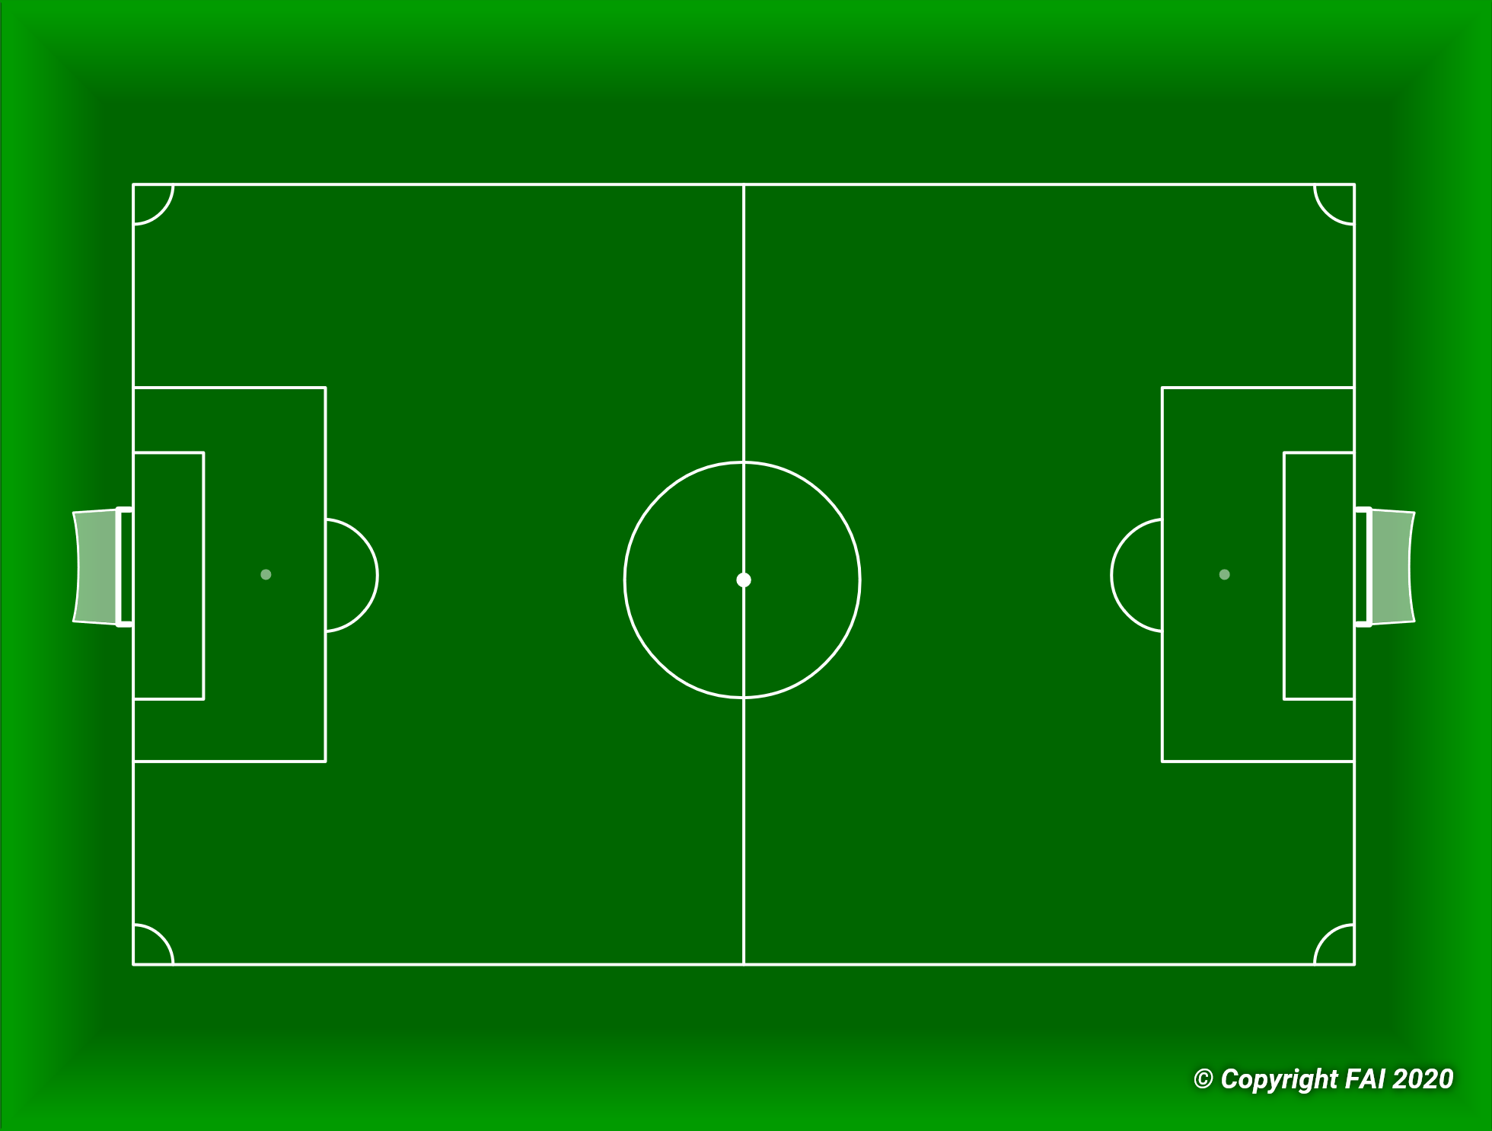


WHEN WE PLAYED OUT
Depending on the Side played out, Wexford pressed that fullback High to pin our fullback back
Opposite Fullback tucks in beside CBs to keep 3 at the back
Everyone marked in this Zone

Slide 3



Slide 4

2015
GIRLS
NTFC TEAMS
2016

Slide 5
2015 & 2016
2015
2016 & GIrls
2014

Slide 6
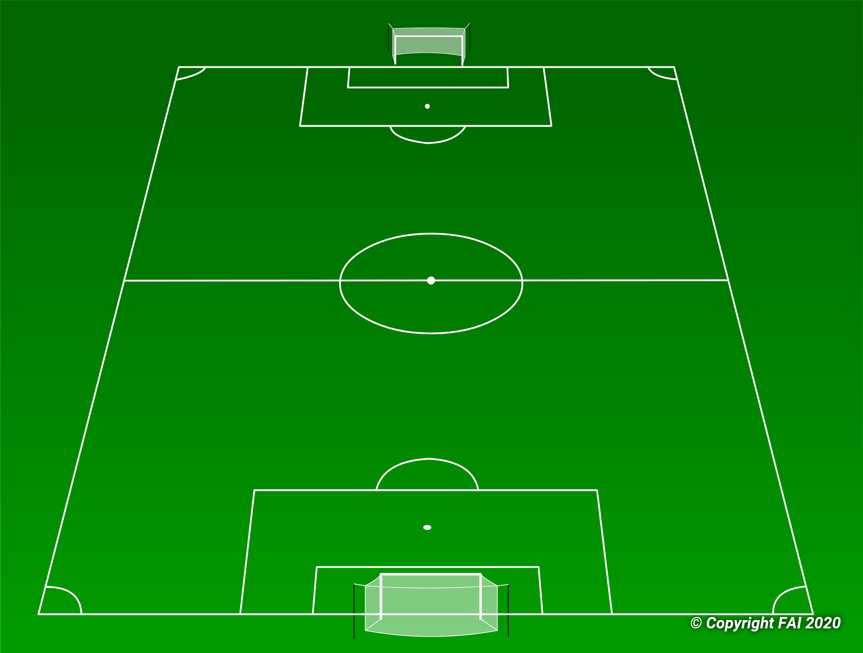


Slide 9
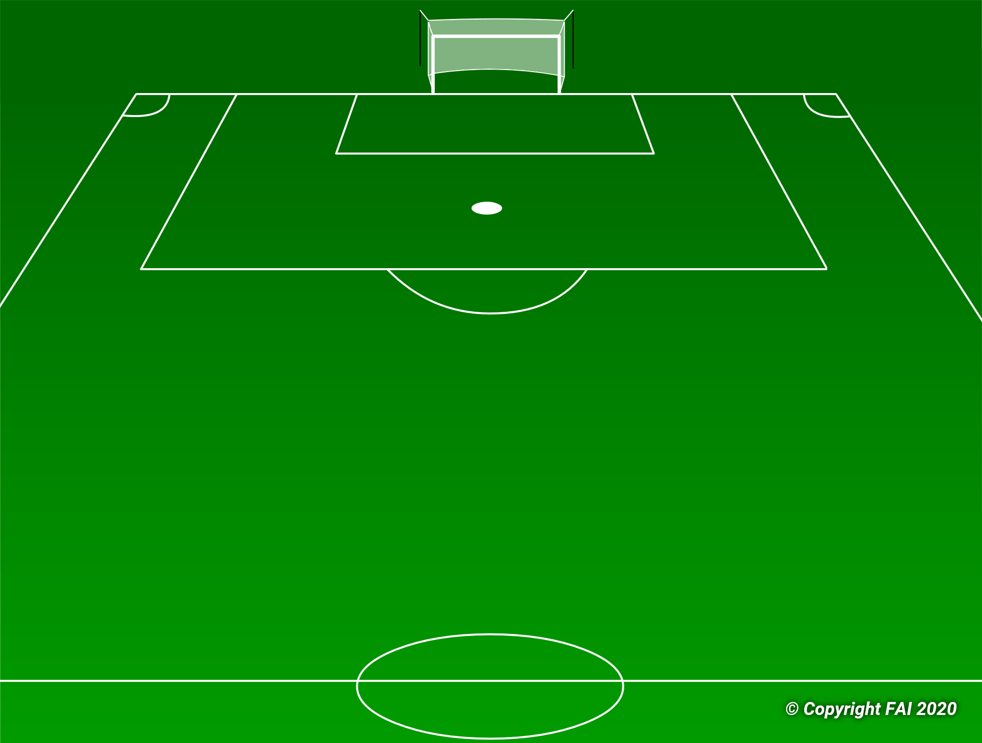

Slide 11
Notes:

Slide 12
Notes:

Slide 13






Notes:
To build up from
1 v 0
1 v 1
2 v 1
2 v 2
3 v 2
3 v 3
4 v 3
4 v 4
Change sides
Att-Trans to def- def- trans to att- att…….
Notes:
Copy and paste the icon you require. (if you make a mistake just click undo)
Then drag the copied icon to where you want.
You can increase/decrease size of icon as required
You can change colours by selecting the icon and selecting shape fill in drawing tools.
You can use the Powerpoint tools to add other shapes/Characters/Text as required
When done copy/duplicate slide and save as Session Plan…

Slide 14
Session Plan Template

Slide 15




Coaching Practice Plan
How to use:
Copy and paste the icon you require. (if you make a mistake just click undo)
Then drag the copied icon to where you want.
(If you need more of the same icon just click paste again)
You can increase/decrease size of icon as required
You can change colours by selecting the icon and selecting shape fill in drawing tools.
You can rotate icon to desired angle.
You can use the Powerpoint tools to add other shapes/Characters/Text as required
When done copy/duplicate slide and save as Session Plan…
See the sample session plan on next slide

Slide 16
Coaching Practice Plan
Objective
Theme
Organisation
Method
Notes

